Slide 1
Student Seminar - IDP
Presentation 3
Can Ersoy - 13.10.2026

Slide 2
Golden Dataset Validations
Extraction Evaluations
Can be used to improve prompts/descriptions
Main idea is to compare extractions to ground truth (golden dataset entries)
Works without ground truth (other than paper content)
Uses a mix of deterministic and LLM-supported steps

Slide 3
Evaluation
Extractions are evaluated in three aspects (per field):
Groundness: Is there evidence for extracted entries?
Faithfulness: Does the evidence actually match the entry?
Completeness: How many of the fields could be captured?
evidence_span: dict(field, evidence)
“Verbatim text sequences (1 per field - at least 5 words) from the source text grounding each extracted property.”
Notes:
One previous idea I had was to give points to fields according to their existence but doing it via evidence seems to be more reliable due to extraction being done in a way that requires understanding the text…

Slide 4
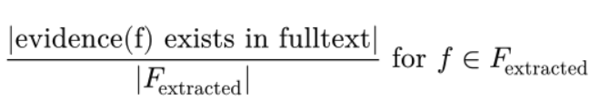
Groundness
Do a deterministic check in fulltext to see if evidence actually comes from the text and is not an hallucination
Direct match
Fuzzy search with a threshold (> 90%)
groundness_rate:
Notes:
Fuzzy search - Levenshtein-based similarity (using rapidfuzz library)

Slide 5
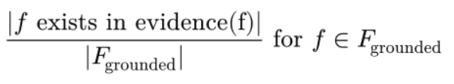
Faithfulness
Use an LLM to compare the field value with the corresponding evidence to figure out if the value actually comes from the evidence. Only on grounded fields.
Example:
- value: 25° C / evidence: room temperature (is_faithfull: true)
- value: 10 pH / evidence: in acidic environment (is_faithfull: false)
faithfulness_rate:
Notes:
Here the system prompt is something like: check if the field value can be inferred from the given evidence… it also provides a reason for its decision for improvement

Slide 6
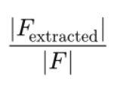
Completeness
How many of the fields are captured. This doesn’t distinguish between LLM couldn’t retrieve the data or the data actually isn’t mentioned in the paper. Hence should be seen as a usefulness metric for downstream tasks.
completeness_rate:
Notes:
For completeness |F| is not always 16, it can happen for example that field peptide_conjugate_mixture is peptide which means there is no conjugate_partner so we don’t penalize that field missing by adjusting the count of F

Slide 7
Example
sequence: NGIWY
evidence_span : {
"sequence": "NGIWY-amide (Asn-Gly-Ile-Trp-Tyr-NH2)"...
}
Groundness: Fulltext (no) / fuzzy search (Match score: 97.3% - yes)
Faithfulness: yes -> Reason: The evidence quote explicitly provides the peptide sequence NGIWY in the name NGIWY-amide.
Notes:
So this is just a simple positive example but I saw cases for improvement. I think these can be solved with some more context in the system prompt that explains some of the fields that don’t have the unit provided

Slide 8
Considerations
Only some of the fields are supposed to have a separate evidence (non-verbatim fields like temp, pH, concentration etc.) Others are directly searched (e.g detection_methods)
Some fields are conditional and not included in completeness check (e.g. conjugate_partner)
Some fields are not considered due to being calculated from other fields (e.g length)

Slide 9
Potential Use Case
For downstream tasks, each aspect can have a meaning and extractions be classified such as:
Weak: Hallucination -> groundness_rate != 1.0
Ok: 0.8 > completeness_rate > 0.7
Strong: completeness_rate > 0.8

Slide 10
Other Ways
Checking the reasoning of the model: It is tricky due to unstructured reasoning
Reiterating on the evaluations: Might improve performance but also not as easy and requires careful implementation
Notes:
Second one is also an idea used in litmof paper so might give it a try

Slide 11
Next Steps
Improve xml parsing + add pdf parsing (to markdown)
Run pipeline and get results (see what we have) or work on a different evaluation method

